Slide 1

MEDIA & THE PUBLIC
Week 12 Selective exposure and biased media diets
Ryan Wang
ryanyang@psu.edu

Slide 2
Van der Meer, Hameleers & Kroon (2020) Crafting Our Own Biased Media Diets: The Effects of Confirmation, Source, and Negativity Bias on Selective Attendance to Online News

Slide 3
Framework
Involvement
Confirmation bias
Country
Source bias
Selective exposure
Issue
Negativity bias
Skepticism

Slide 4
Main purpose
What are the effects of these three selection bias on news selection; and which bias is most decisive?
How robust these influence of three bias are across countries and issues?
The moderating role of people’s involvement and skepticism between the three selection bias and news selection

Slide 5
Confirmation bias as a driver
Definition: individuals actively restrict themselves to messages that align with preexisting political attitudes and beliefs (Iyengar & Hahn, 2009; Stroud, 2008)
Selective exposure is strongly related to people’s preferences for attitudinal congruent information. people select messages that confirm prior beliefs to maintain a consistent and positive image of the self.
Is selective exposure to attitudinal congruent content a remedy for reducing cognitive dissonance – probably not that consistent (Garrett, 2009)
Other mechanism: people’s information processing style can be decisive in selecting attitude-consistent content over attitude-discrepant exposure
It requires less cognitive effort and engagement to process like-minded information as compared to information that converges with
H1: People are more likely to selectively expose themselves to political news that confirms their prior attitudes than news that attacks their existing beliefs.

Slide 6
Source bias as a driver
Definition: The overload of information available might force audiences in habitual news selection patterns based on easy to process heuristics like the source of information (Diddi & LaRose, 2006; Van der Meer, 2018)
A routine process
A guiding mechanism (attitudinal stance and political ideology)
The premises of the hostile media and friendly media perception
Hostile media perception: media coverage on a highly involved issue is biased against their view (Choi et al., 2009)
Friendly media phenomenon: audiences tend to perceive media sources and content that support their political attitudes as friendly (Goldman & Mutz, 2011)
H2: People are more likely to selectively expose themselves to political news from ideologically congruent media sources than news from ideologically incongruent media sources.
Notes:
This could result in a source bias where news consumers use the source of a news item as an easy cue or heuristic to determine whether they would select the article to read. It occurs when people show a tendency to avoid engaging in repeated active news selection. Since source bias can also be affected by users’ preexisting political orientations (Choi et al., 2009), this bias can be understood as a special case of the confirmation bias on a preceding stage of news selection. As a consequence, people may routinely prefer certain news sources while avoiding others, either based on their pre- existing political orientations or based on their customary and repetitive patterns of news selection. Thus, people may not only judge the fit of informa- tion based on prior attitudes, but also on the expectation that certain sources can deliver sought gratifications.
audiences’ news selection might be based on which outlet or platform the news comes from, primarily as a routine process. Such cus- tomary and repetitive patterns might help people navigate in a high-choice news environment that overloads them with information from a wide variety of news sources.
This bias may thus be driven by a form of confirmation bias in the first place: attitude-congruent exposure may create habitual exposure patterns on a longer term because audiences may develop expectations about which sources can deliver attitude-consistent information. Source bias and confirmation bias can be strongly related. It should be noted that this process may operate on a more or less unconscious level, indicat- ing that source cues are not always processed systematically.
same information distributed by a rival media source is seen as more hostile than the same information advocated by a supported outlet.
general political favoritism toward media outlets is experienced when media sources support people’s perceptual screens. This phenomenon is also found to limit cross-cutting exposure – and therefore cultivates reliance on habitual news exposure.
people should be most likely to select information coming from news sources they support as an easy to process heuristic, whereas they avoid information of sources they oppose.

Slide 7
Negativity bias as a driver
Definition: audiences exhibit a (unconscious) preference for negative over positive political news (Trussler & Soroka, 2014)
News reporting strategy: Negativity is as an instrumental value in the competition for audiences’ attention (Lengauer et al., 2011)
People’s preference: build-in mechanism, as an outcome of the evolutionary process, to scan their environment for threat (Soroka & McAdams, 2015)
H3: People are more likely to selectively expose them- selves to political news that is negatively valenced than positively valanced news.
Notes:
in the abundance of (online) news choices, another attention-grabbing cue or unconscious desire might play a decisive role.
These preferences might result from the fact that people are genetically wired to pay close attention to negative news (Lengauer et al., 2011) or have an intrinsic desire for entertainment or attractive news.
In general, negativity, as compared to positivity, is considered more entertaining, interesting, eye-catching, and understandable. Accordingly, as a result of the impact of competition and commercialization within the media system, media and their journalists tend to overemphasize negative news in an effort to obtain the highest ratings
Information with a negative valence has a stronger effect on evaluations than equally strong positive information. Hence, negative events are more salient, con- tagious, dominant, and efficacious compared to positive events. Negativity consequentially has a stronger impact on physiological arousal, perceptions, attention, and learning

Slide 8
Three selection bias as drivers
RQ1:
(a) What are the relative roles of conformation bias, source bias, and negativity bias in predicting selective exposure to political news?
(b) Are the effects of these biases robust when comparing two political issues (immigration and health-care privatization) and two countries (US and UK)?

Slide 9
Moderators
Involvement
Confirmation and source bias: Heavy media users, strongly emerged and involved with salient issue in the news, are likely aware of the diverse pallet of opinions distributed by the media, giving rise to the possibility that hostile media effects will drive selection.
Negativity bias: negativity bias is more decisive regarding the outcome of selection patterns among those high in need for and tolerance of negative and entertainment news than those who are not.
H4: When individuals are generally more involved/interested, the effects of (a) confirmation bias, (b) source bias, and (c) negativity bias on selective exposure are more pronounced.
Notes:
individuals highly involved with an issue are likely to hold more extreme attitudes, which could lead them to experience greater dissonance if confronted with counter-attitudinal information.
Heavy media users, strongly emerged and involved with salient issue in the news, are likely aware of the diverse pallet of opinions distributed by the media, giving rise to the possibility that hostile media effects will drive selection.
individual-level variation in terms of predispositions toward negativity (Hibbing et al., 2014) and a need for entertainment in political information

Slide 10
Moderators
Skepticism
Political skepticism: politically skeptical individuals might be particularly attracted by congenial information and actively filter out opposing arguments and less motivated to scrutinize the viewpoints of opponents.
Media skepticism: individuals who have grown skeptical of media sources may be more prone to view such sources as being unfair or biased against their viewpoints, which may consolidate the tendency to avoid such sources.
Skepticism toward negativity: : Skeptical individuals might be more prone to focus on pitfalls than promises. Accordingly, skeptical news consumers might be especially drawn to deviant or negative information.
H5: For individuals with higher (as opposed to lower) preexisting levels of skepticism toward politics, media, and negative political news, the effects of (a) confirmation bias, (b) source bias, and (c) negativity bias on selective exposure are more pronounced.

Slide 11
Factorial design
A 2*2*2*2 within-subjects factorial design:
Confirmation bias: pro- vs. counter-immigration/public health-care framing of news item)
Source bias: source of news item in line with peoples’ political leaning or not, distinguishing between more liberal or conservative news outlets
Negativity bias: news items negatively valenced vs. positively valenced
Isue: immigration vs. health care
(Country: US vs. UK – NYT/The Guardian vs. Fox/The Sun)
Eight stimuli (news headlines) in social media or online newsfeed-style news

Slide 12
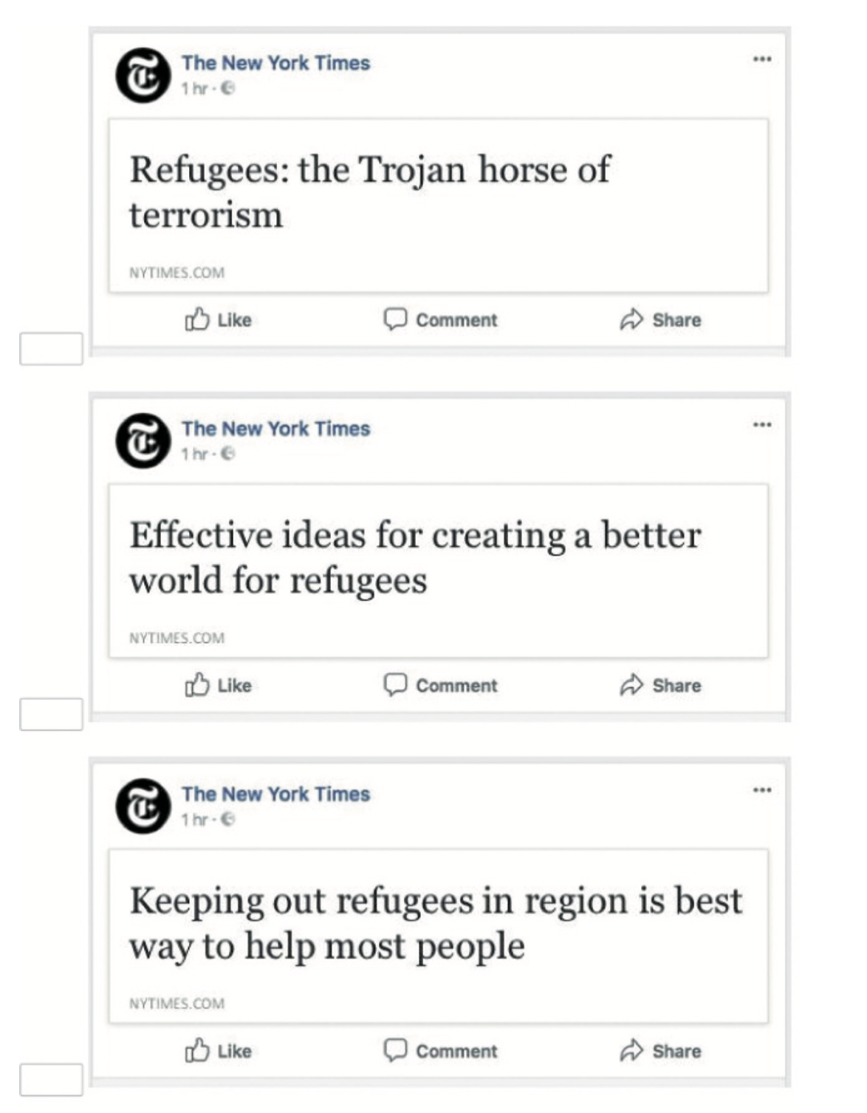
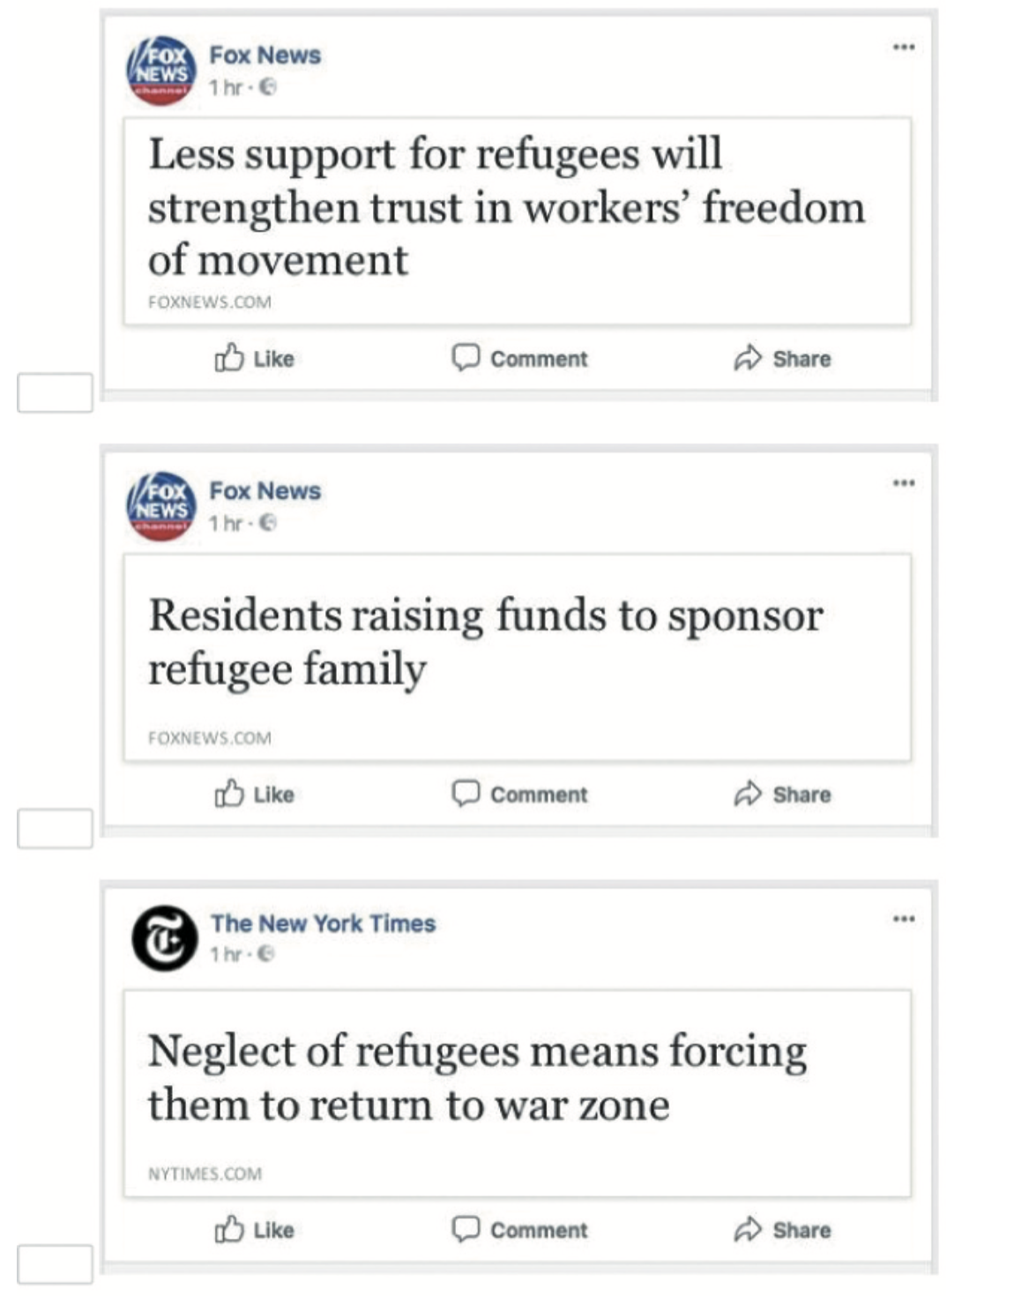
Notes:
The order in which the issues were presented was randomized (for both the ranking option and the likelihood of selecting). Also, the within-issue pairings of the different sources and headline exemplars were randomly allocated. In doing so, different combinations per source-headline pairing were presented to participants to control for the chance that a specific combination of source and headline would be more appealing to respondents.

Slide 13
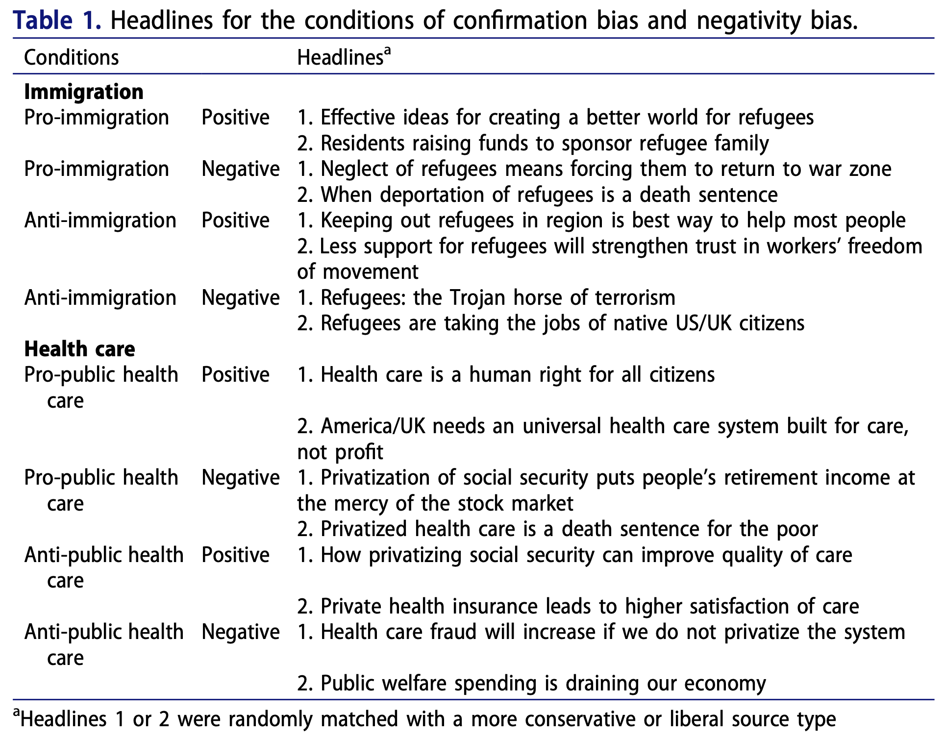

Slide 14
Measurement
Dependent variable: selective exposure
Selection measurement
Rank the headline news items and indicate their top three out of the eight items that they would most likely choose to read.
Whether participants selected certain news items over others based on the presented headline and source in a setting where they are exposed to multiple option
Likelihood of reading news items
The likelihood that they would select each news item to read when they would come across it in their everyday life on a scale from 0 “very unlikely” to 100 “very likely.”

Slide 15
Measurement
Attitudinal congruence
On a scale from 1 to 7, please indicate how strongly you support or oppose that immigrants are entering the UK/US
On a scale from 1 to 7, please indicate whether you support or oppose privatizing the health care system (e.g., health care) (as compared to a public health care system).”
Independent variable: selection bias
Coded as 1 if the news item was congruent with ones preexisting attitude for confirmation bias:
Coded as 1 if the news item was coming from an ideologically congruent source for source bias,
Coded as 1 if the news item was negatively valenced for negativity bias.
Notes:
To split respondents based on their political attitudes toward immigration and health care, we used the attitude questions that were asked at the start of the survey
Those who scored 1 through 3 were labeled as opposing, those who scored 5 through 7 were labeled as supporters. Respondents who answered 4, neither oppose nor support, were excluded.
They constructed new conditions based on congruence between participants’ attitude and the headline’s stance on the political issues and the sources. Headlines and sources were considered congruent.
if they were in line with respondents’ existing immigration/health care attitudes and were coded as incongruent if they countered their views on immigration/health care.

Slide 16
Measurement
Moderators
Involvement
Confirmation bias: political opinion strength or attitude extremity
Source bias: frequency of news consumption (with most common sources)
Negativity bias:
Interests in negative news
I do not mind negative news items
I prefer news items that attack politicians for their misconduct
Need for entertainment in political news or affinity for political humor
Entertainment in political news ... makes me aware that our political system is dysfunctional/can help me express my political opinions
Skepticism
Political skepticism
Media skepticism
Skepticism towards political news being overly negative

Slide 17
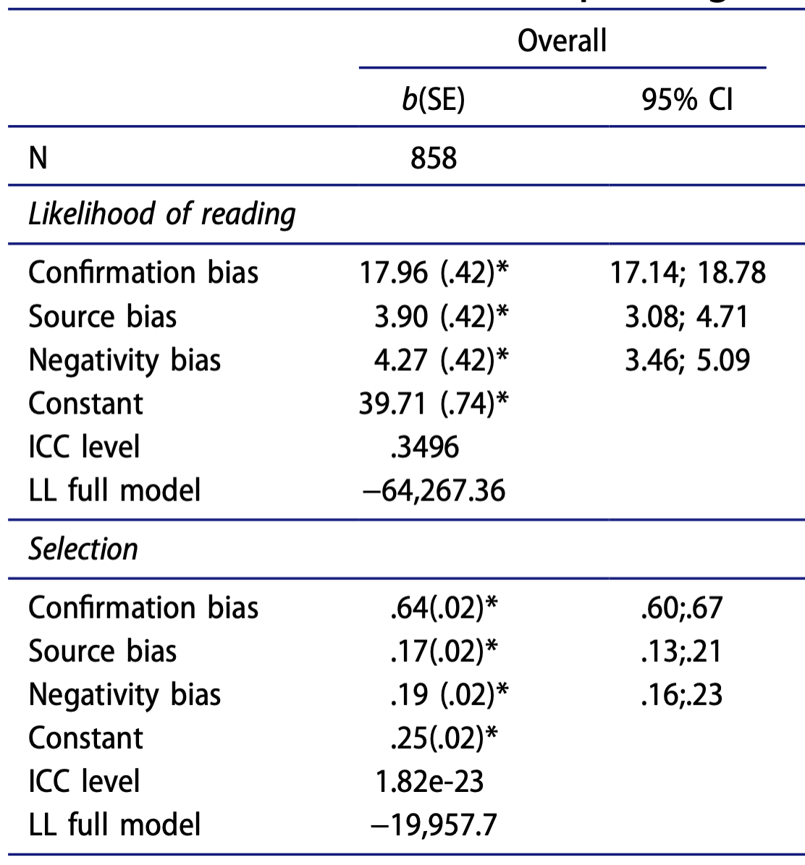
Results
H1
H2
RQ1(1)
H3
RQ1(1)
Notes:
Additional post-estimation tests confirmed that the effect of confirmation bias on likelihood of reading is significantly higher than the effect of source bias and negativity bias, while the effect size difference between source and negativity bias was insignificant. Same for selection

Slide 18
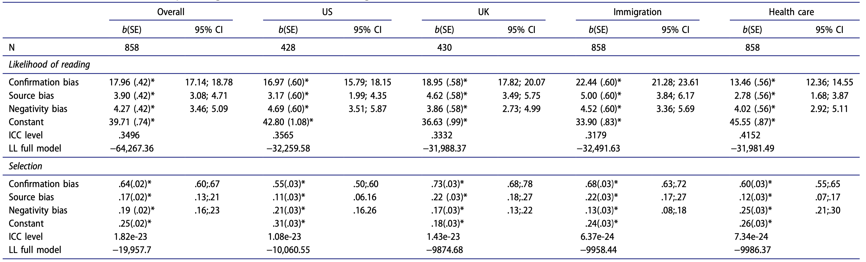
Robustness check
RQ1(b)
RQ1(b)
Notes:
Based on the findings presented in Table 2, we can observe that the effects of all three biases are consistently significant for both issues and in both countries. Thus, it can be concluded that the effect of the confirmation bias, source bias, and negativity bias is robust across different contexts in a way that they play a significant role in the selection of political news.

Slide 19
Robustness check
Issue:
Confirmation bias and source bias are more important factors in the likelihood of selecting news on immigration as compared to news about the privatization of health care
Country:
Confirmation bias and source bias were found to be stronger predictors for the UK context compared to the US while the effect of negativity was equally strong.
Notes:
Next, to test if the effects are significantly more profound across contexts, additional analyses were run using issue and country as interaction terms in the regression model.

Slide 20
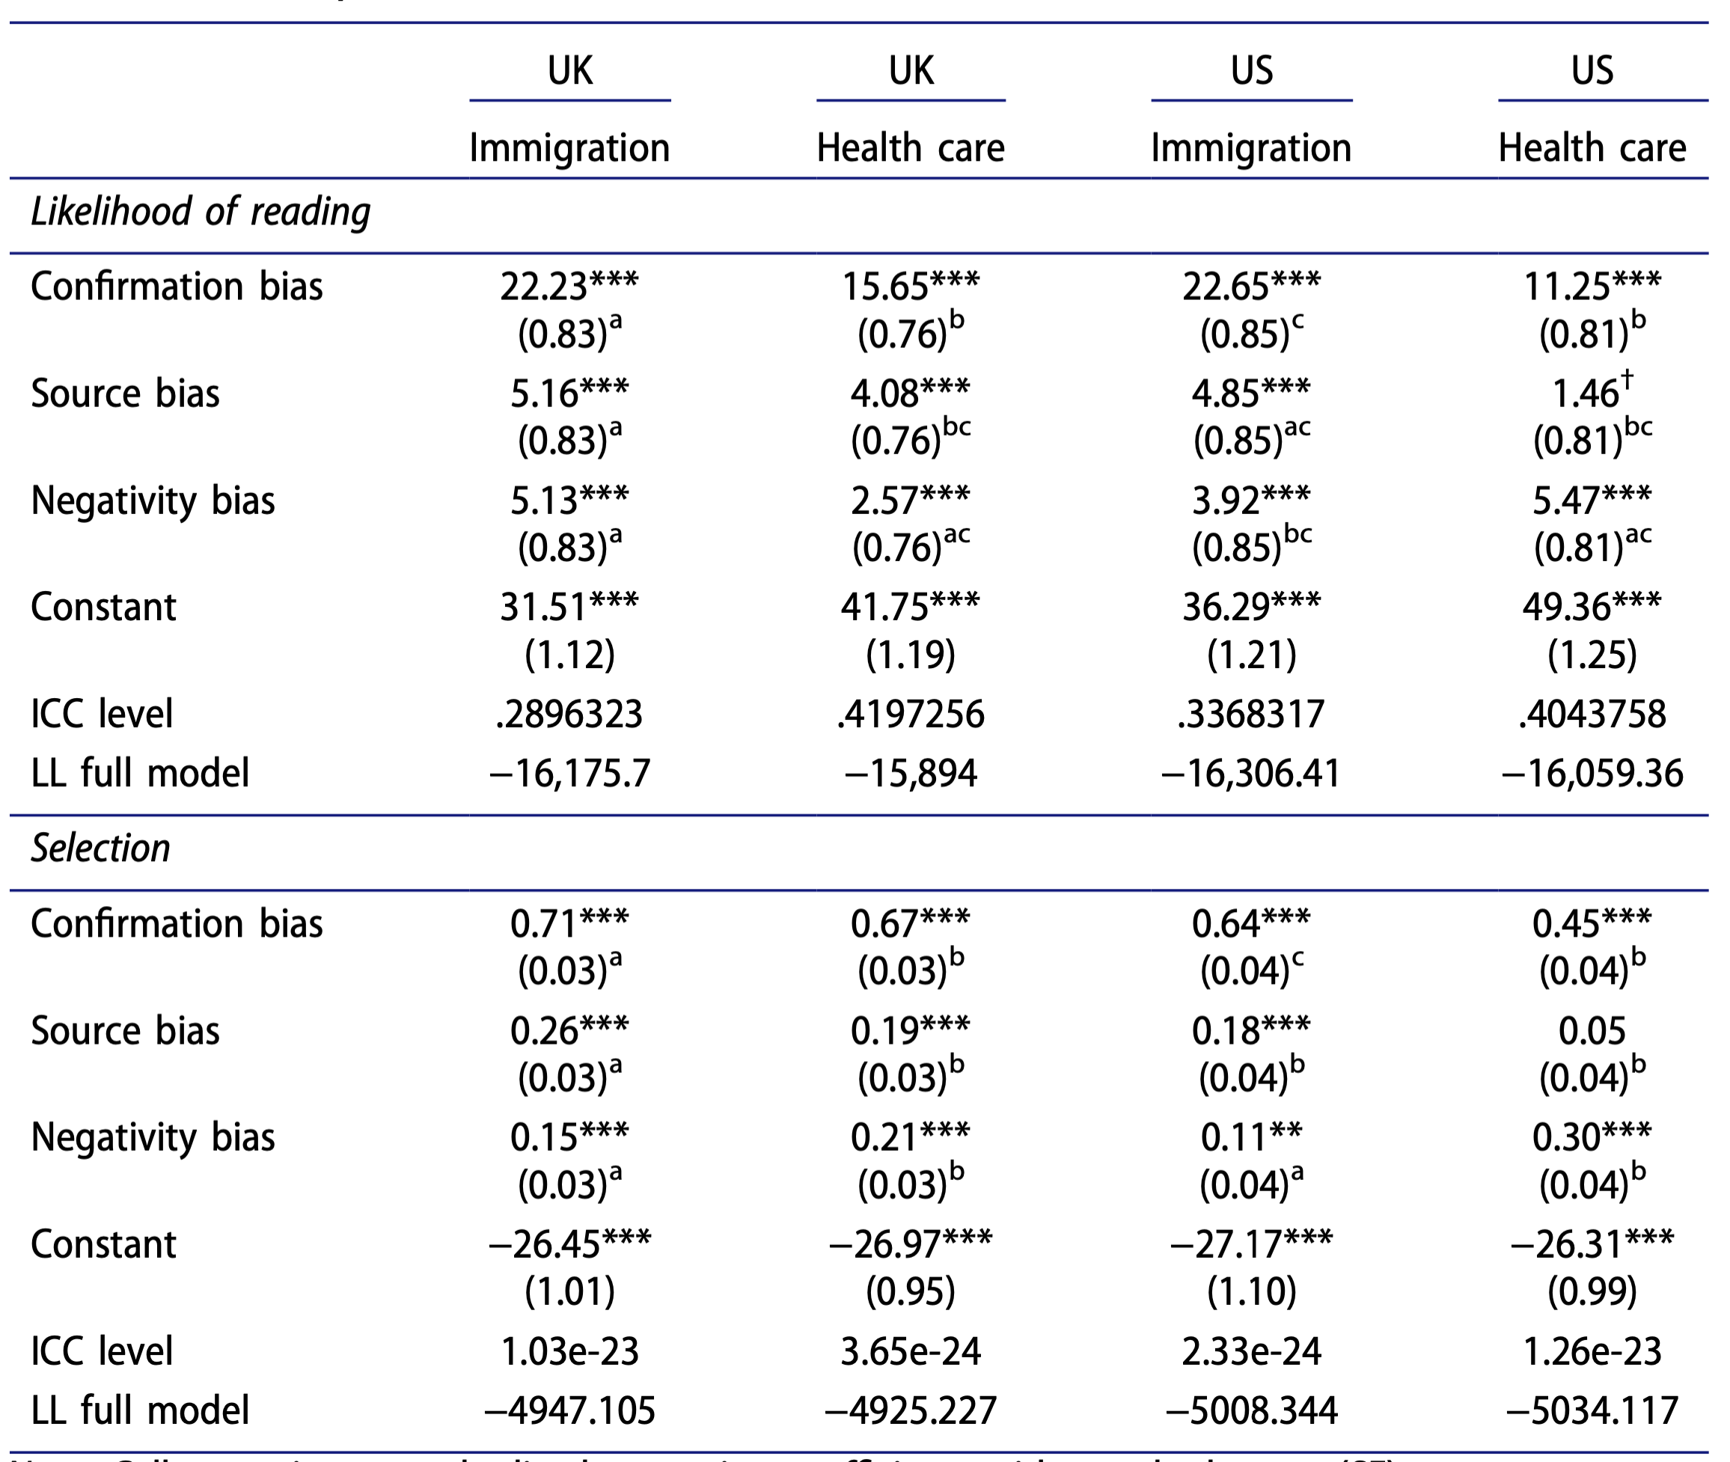
Notes:
confirmation bias is the strongest in the UK for the issue of immigration, in terms of likelihood of reading and selection, compared to the other combinations of issue and country; confirmation bias in both countries is stronger for the immigration issue than for the health-care issue.
the source bias shows also the strongest effects in the UK for the issue of immigration
the effect of the negativity bias appears to be most pronounced in the UK for the immigration issue whereas it is more prominent for the health-care issue in the US.

Slide 21
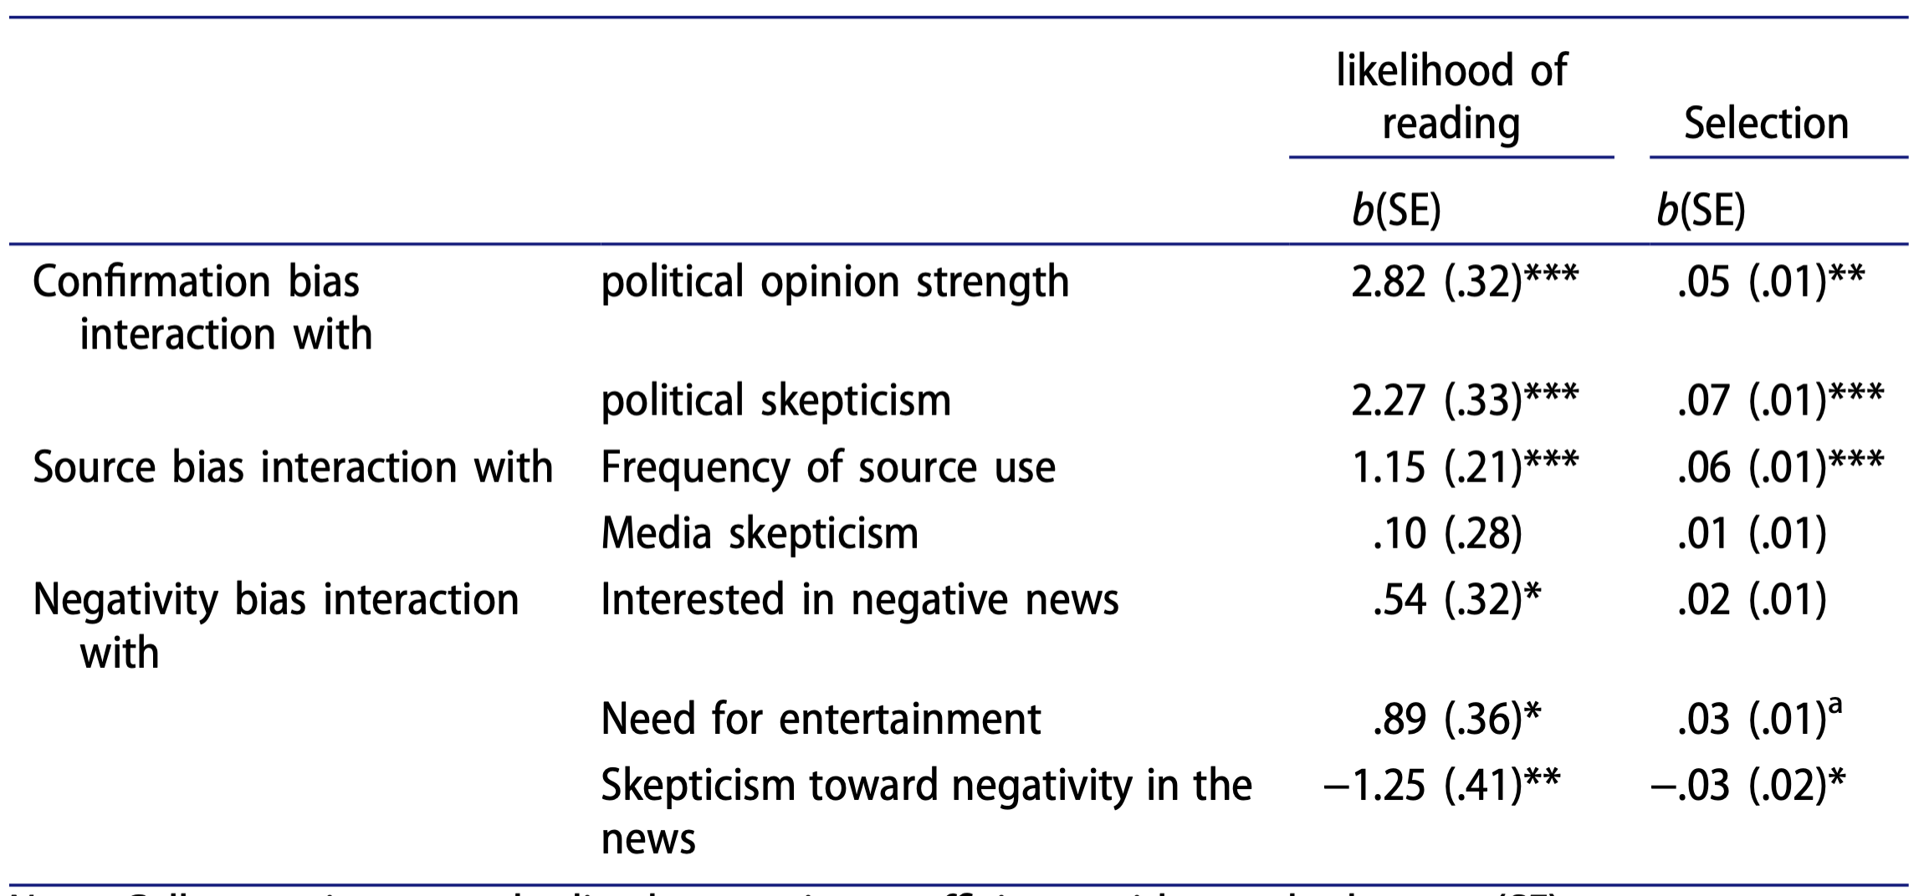
Results
H4(a)
H5(a)
H4(b)
H5(b)
H4(c)
H4(c)
H4(c)
H4(c)
H5(c)

Slide 22
Key takeaways
All three selection bias drive selective exposure, and that these biases are robust across different highly polarized topics and countries
Confirmation bias has the strongest impact on selective exposure
Source and negativity bias play a less central, yet significant role
Individual-level differences drive conditional impact of the different drivers of selective exposure
Confirmation and source biases are more pronounced amongst more involved people
Defensive motivated reasoning
People who preferred negative news and enjoyed entertainment in political news had a stronger desire to select negative news items, whereas people who demonstrated a more skeptical view on negative news tended to avoid it (and also have a lower level of likelihood)
Selective exposure is also contingent upon the congruence of certain news preferences and the valence of political news.
More (political) skeptical and less critical individuals foster polarized divides and distorted worldviews.
Notes:
More specifically, people with stronger opinions may regard challenging information and sources as a stronger attack on their existing beliefs and reassuring information as more relevant resources to consolidate a consistent image of the self
more political skeptical individuals are more likely to demonstrate a confirmation bias,
Yet, when individuals are more critical toward the news, their negativity bias is less pronounced

Slide 23
Reference
Eveland Jr, W. P. (2001). The cognitive mediation model of learning from the news: Evidence from nonelection, off-year election, and presidential election contexts. Communication research, 28(5), 571-601. https://doi.org/10.1177/009365001028005001
Nanz, A., & Matthes, J. (2022). Democratic Consequences of Incidental Exposure to Political Information: A Meta-Analysis. Journal of Communication. https://doi.org/10.1093/joc/jqac008

